Slide 1


SocialBuzz

Slide 2


Today's agenda
Project recap
Problem
The Analytics team
Process
Insights
Summary

Slide 3

Social Buzz is a fast-growing company that need to adapt quickly to its global scale.
An audit of Social Buzz’s big data practice
Recommendation for a successful IPO
Analyse the data
Project Recap

Slide 4

Problem
Over 100000 posts per day
36500000 pieces of content per year !
Analyze to find the Social Buzz’s top 5 most popular categories of content

Slide 5



Andrew Fleming
(Chief Technical Architect)
The Analytics team
Marcus Rompton
(Senior Principle)
Shahabas KM
(Data Analyst)

Slide 6
Process
1
Data Understanding
2
Data Cleaning
3
Data Modelling
4
Data Analysis
5
Uncover Insights

Slide 7

Insights

Slide 8
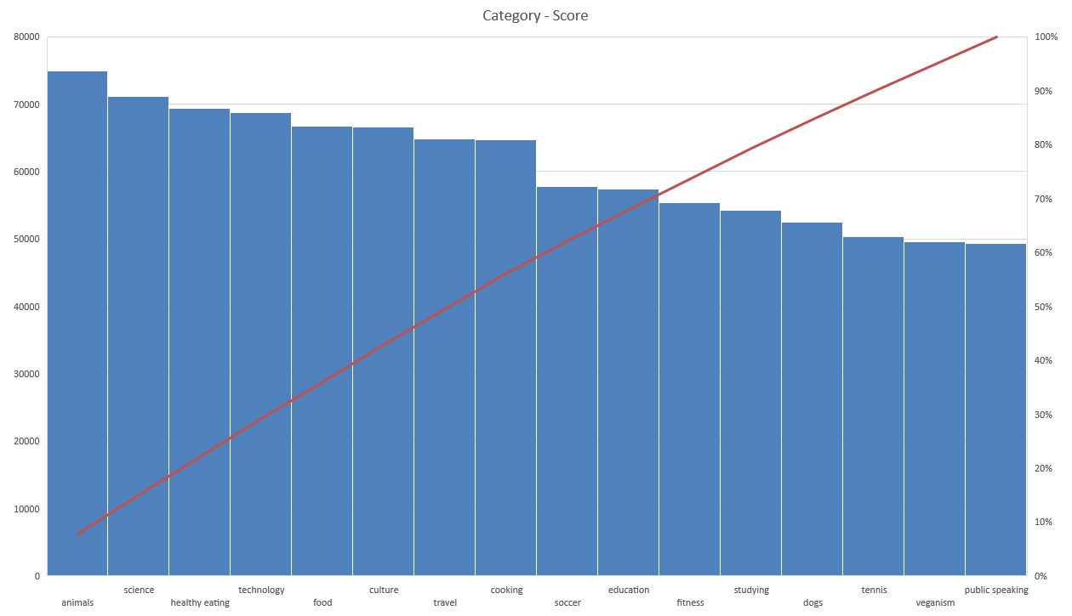

Slide 10

After analyzing the whole, we could infer the insights that the top 5 categories where Animals, Science, healthy eating, technology and food.
The topmost reaction type is heart reaction counting – 1625
The sentiment is positively biased
Summary

Slide 11
Thank you!
ANY QUESTIONS?

